Slide 1

CREDIT CARD WEEKLY
STATUS REPORT
Presentation By: R Jayant

Slide 2
PRESENTATION AGENDA
1
Objective
2
Action
3
Dashboard
4
Insights
5
Suggestions

Slide 3




1
Objective
Enable clients to monitor and analyze credit card operations effectively
Develop a comprehensive credit card weekly dashboard
Key performance
metrics and trends
Provides real-time insights

Slide 4

2
Action
1
DATA GATHERING
Connect to data source
Load data
Transform data

Slide 5


2
Action
1
2
DATA GATHERING
DATA MODELLING
Connect to data source
Load data
Transform data
Define relationship
Create DAX measures

Slide 6


2
Action
1
2
3
DATA GATHERING
DATA MODELLING
REPORT DEISGN
Connect to data source
Load data
Transform data
Define relationship
Create DAX measures
Choose visualization
Arrange visuals
Apply filters & slicers

Slide 7


2
Action
1
2
3
4
DATA GATHERING
DATA MODELLING
REPORT DEISGN
FORMAT & STYLE
Connect to data source
Load data
Transform data
Define relationship
Create DAX measures
Choose visualization
Arrange visuals
Apply filters & slicers
Modify Visual Properties
Add Titles and Annotations
Set Themes

Slide 8


2
Action
1
2
3
4
5
DATA GATHERING
DATA MODELLING
REPORT DEISGN
FORMAT & STYLE
DATA ANALYSIS
Connect to data source
Load data
Transform data
Define relationship
Create DAX measures
Choose visualization
Arrange visuals
Apply filters & slicers
Modify Visual Properties
Add Titles and Annotations
Set Themes
Drill down into details
Ad-hoc analysis
Anomalies
Identify trends

Slide 9
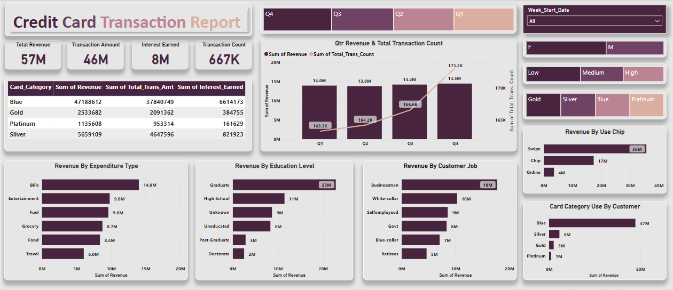
3
Dashboard

Slide 10
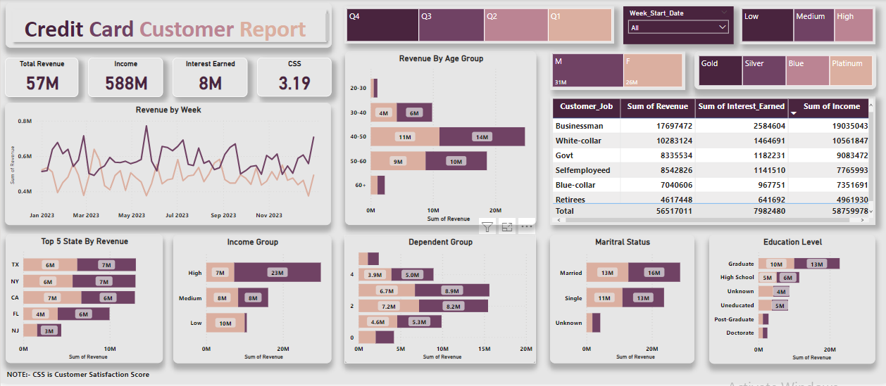
3
Dashboard

Slide 11
4
Insights
Week-on-week change
28.8%
123.5%
2.27%
1.74%
REVENUE INCREASED
TRANSACTION AMOUNT INCREASED
CUSTOMER COUNT INCREASED
TRANSACTION COUNT INCREASED

Slide 12
4
Insights
Overview of Year-to-Date
57M
46M
8M
31M
26M
OVERALL REVENUE
TRANSACTION AMOUNT
TOTAL INTEREST
REVENUE BY MALE
REVENUE BY FEMALE
93%
68%
57.5%
6.06%
CONTRIBUTION BY BLUE & SILVER CARD
CONTRIBUTION BY TX, NY, CA
ACTIVATION RATE
DELINQUENT RATE

Slide 13

5
Suggestions
01
Customer Satisfaction Score
Current score – 3.19
Survey Analysis
Customer Engagement
Product and Service Enhancements
Customer Support and Assistance

Slide 14

5
Suggestions
01
02
Customer Satisfaction Score
Current score – 3.19
Platinum & Gold Credit Card
Current Contribution – 7%
Survey Analysis
Customer Engagement
Product and Service Enhancements
Customer Support and Assistance
Enhanced Rewards and Benefits
Targeted Marketing and Promotions
Personalized Recommendations
Exceptional Customer Experience

Slide 15

5
Suggestions
01
02
03
Customer Satisfaction Score
Current score – 3.19
Platinum & Gold Credit Card
Current Contribution – 7%
Delinquency Rate
Current Rate – 6.06%
Survey Analysis
Customer Engagement
Product and Service Enhancements
Customer Support and Assistance
Enhanced Rewards and Benefits
Targeted Marketing and Promotions
Personalized Recommendations
Exceptional Customer Experience
Enhance Risk Assessment and Underwriting.
Offer Financial Education and Counseling.
Implement Early Warning Systems.

Slide 16
Got Questions? ASK IN THE COMMENT
THANK YOU
Like, Comment & Share

